Slide 1
Dunking the Winning Formula
Predicting NBA playoff contention from team stats

Slide 2

NBA Team Stats Season 2021-2022
Taken from Basketball Reference
Manually compiled with love and care by yours truly
Includes 30 rows (1 per team) and 61 columns
Has four feature categories
Keyword being “season” so it only involves regular season performance

Slide 3
Scope and Limitations
1
The game is ever-changing and evolving, officiating and trending playstyles are different per era of basketball.
2
If major rule changes are to take place right before a season that is to be subject to prediction given these methods, insights may lose weight.
3
This kind of method of prediction may move differently in seasons where analytics were less evolved, with less of these stats introduced then.
4
In the same way, should new derived stats be introduced, results could change as well.

Slide 4
Feature Categories
Basic Stats
Points per game
Field goal accuracy
Assists per game
Total rebounds per game
Advanced Stats
Average age
Offensive and Defensive Rating
Average possessions per 48 minutes
True shooting percentage
Shooting Stats
Average shot distance
Percentage of field goals attempted from 0 to 3, 3-10 and 10-16 feet
Dunks made
Layups made
Predictive Stats
Predicted wins
Predicted losses
Jupiter is a gas giant
Mercury is the smallest
Notes:
Basic Stats: Includes fundamental per game counts and averages
Advanced Stats: Include derived stats from basic averages and non-basic counts and averages
Shooting Stats: Include data on data percentage of shot attempts per distance and respective accuracy
Predictive Stats: These involve projections of player and team performance.

Slide 5
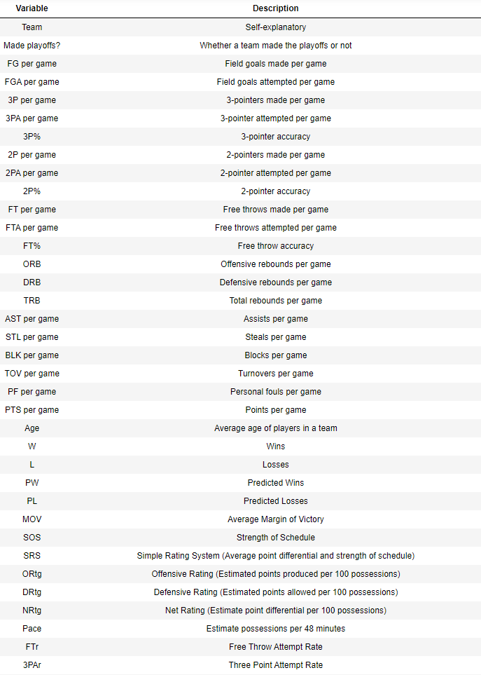
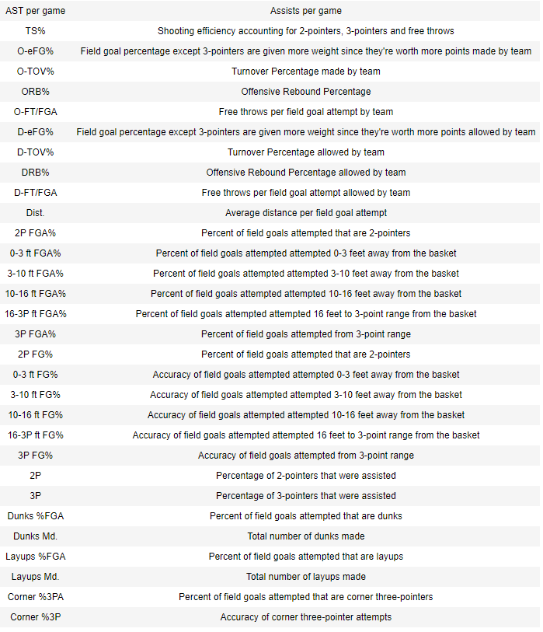
Features

Slide 6
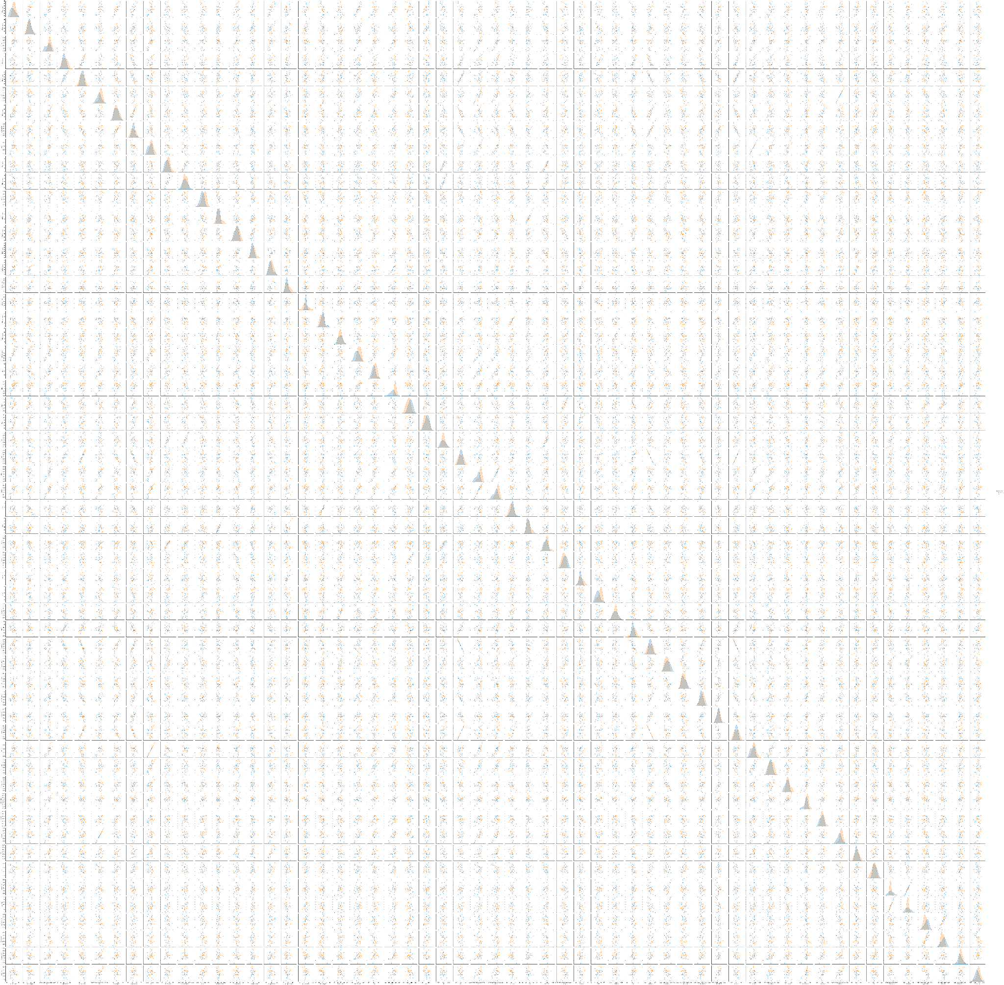
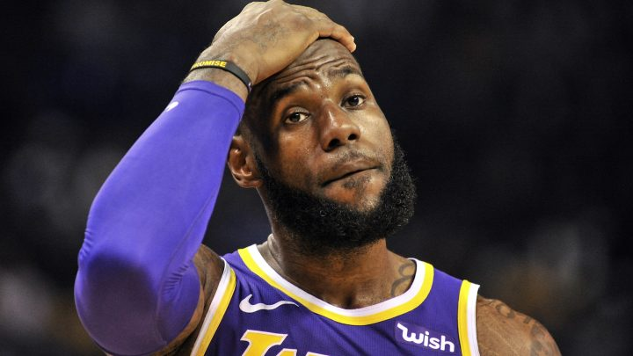
Collinearity Analysis
Same, LeBron. Same.

Slide 7
More obvious collinearities
The more two-pointers you attempt, the higher your 2P FGA% and 2-pointers made are; same applies with three-pointers and related stats
The higher your 3P FGA%, the lower your 2P FGA% is and 2-pointers attempted and made are
The more attempts you have, the more makes you'll have (That's how volume shooting works)
General accuracy stats are collinear with derived accuracy stats such as TS% and eFG%
Higher average distance means less 0-3 and 3-10 ft FGA% and more 10-16 and 16-3P FGA%, it can also mean more three-pointers attempted per game

Slide 8

Intriguing collinearities and the lack of thereof
Age average and FG%: May suggest with age comes both maturity and wiser shot selection and therefore a more refined skillset
Turnovers and steals not having collinearity: Turnovers don't always translate to steals, this is because it could happen from committing violations and stepping out of bounds
Steals and dunks/layups not having collinearity: Steals don't always translate to dunks or layups, converting points out of turnovers is an art and entirely new challenge in itself - transitions in between playing offense and defense are important

Slide 9
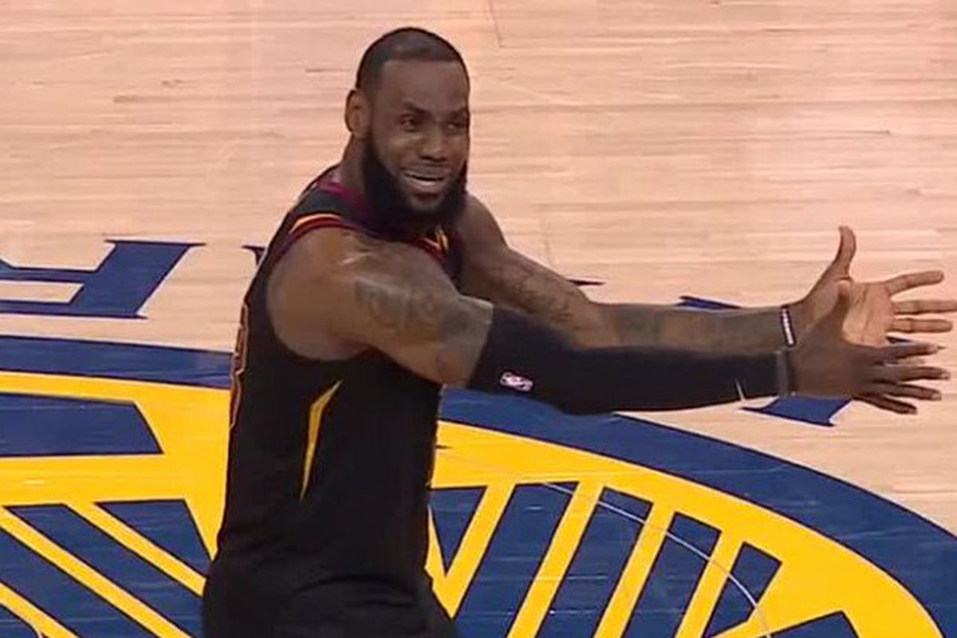
Model Tests

Slide 10
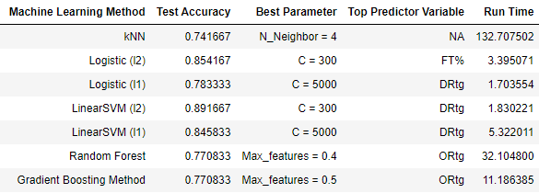
All Stats
DRtg and ORtg reign supreme over other predictor variables with FT% edging the others in one of the models. DRtg and ORtg measure defensive and offensive potency, so having better values for both would lead to more success

Slide 11
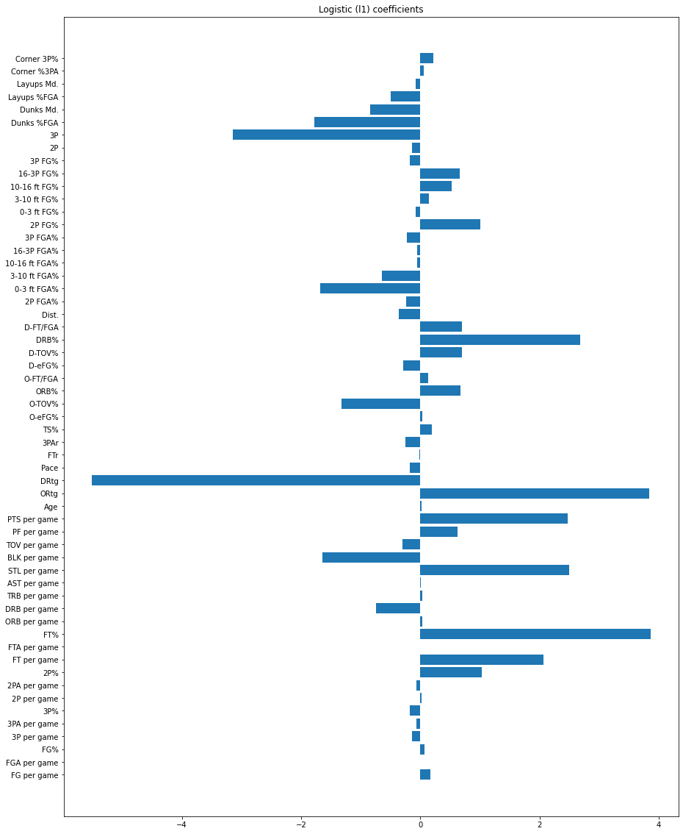
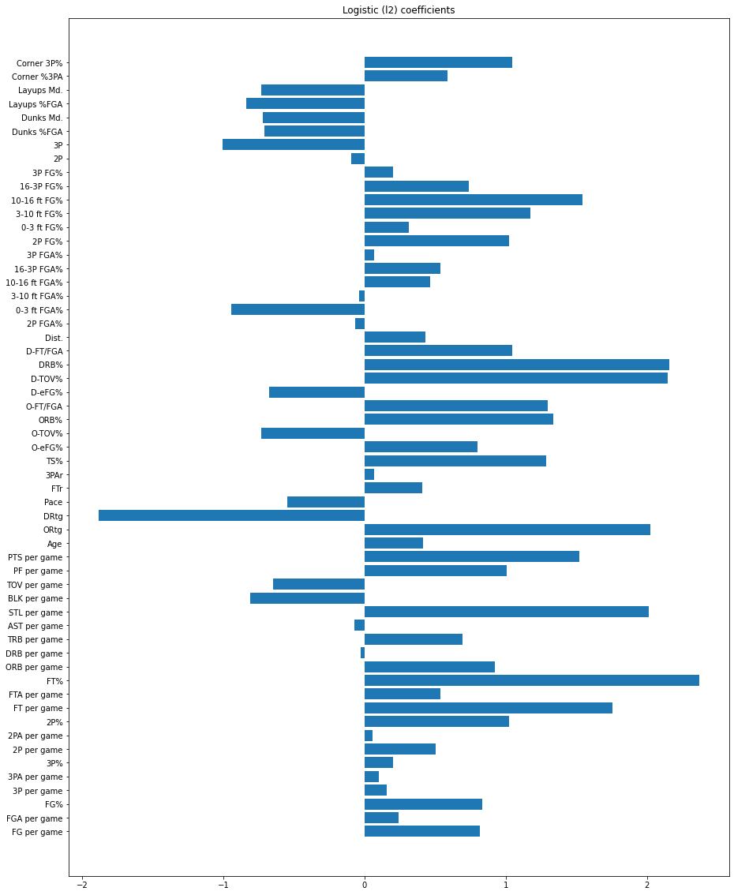
All Stats

Slide 12
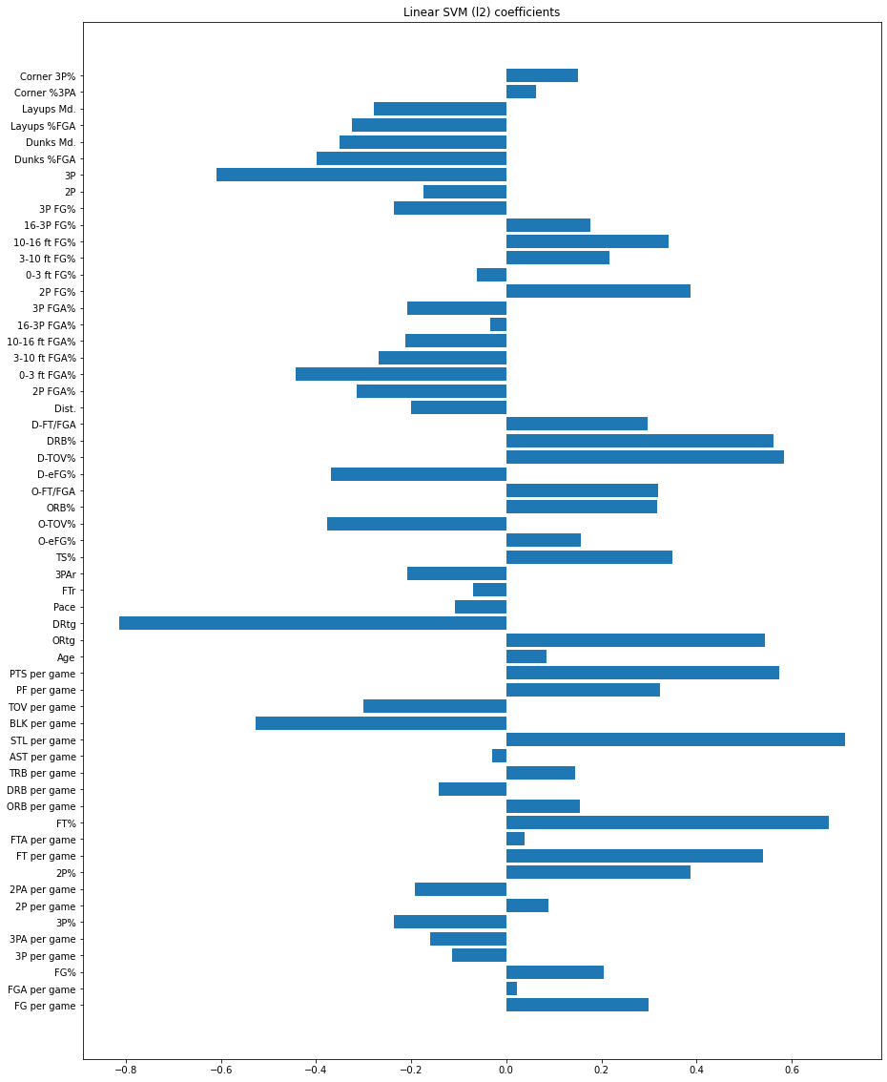
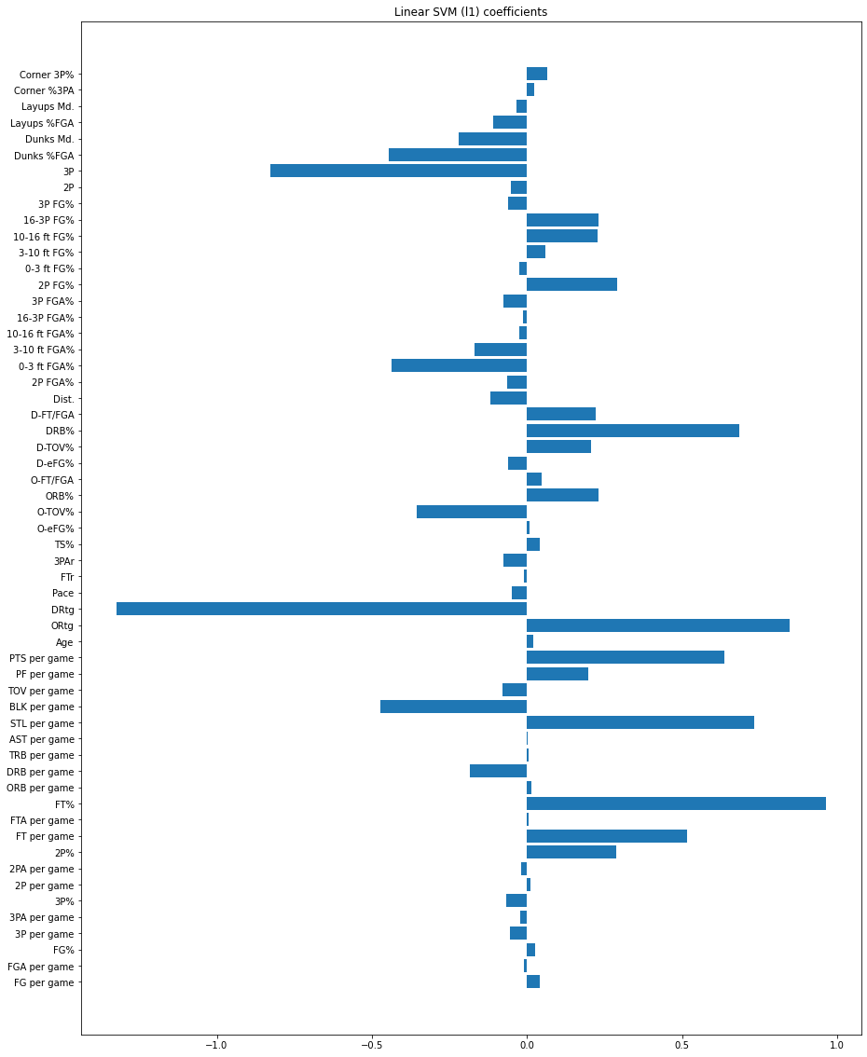
All Stats

Slide 13
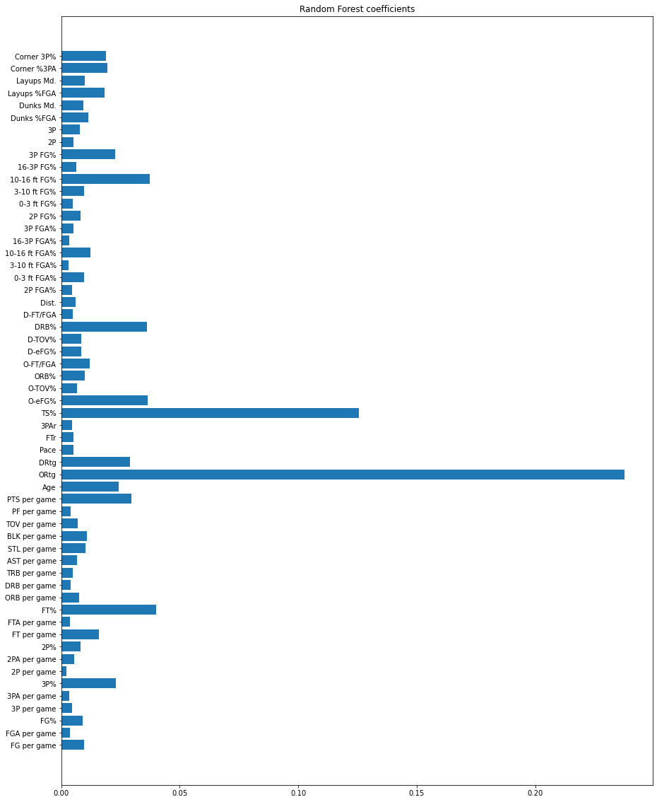
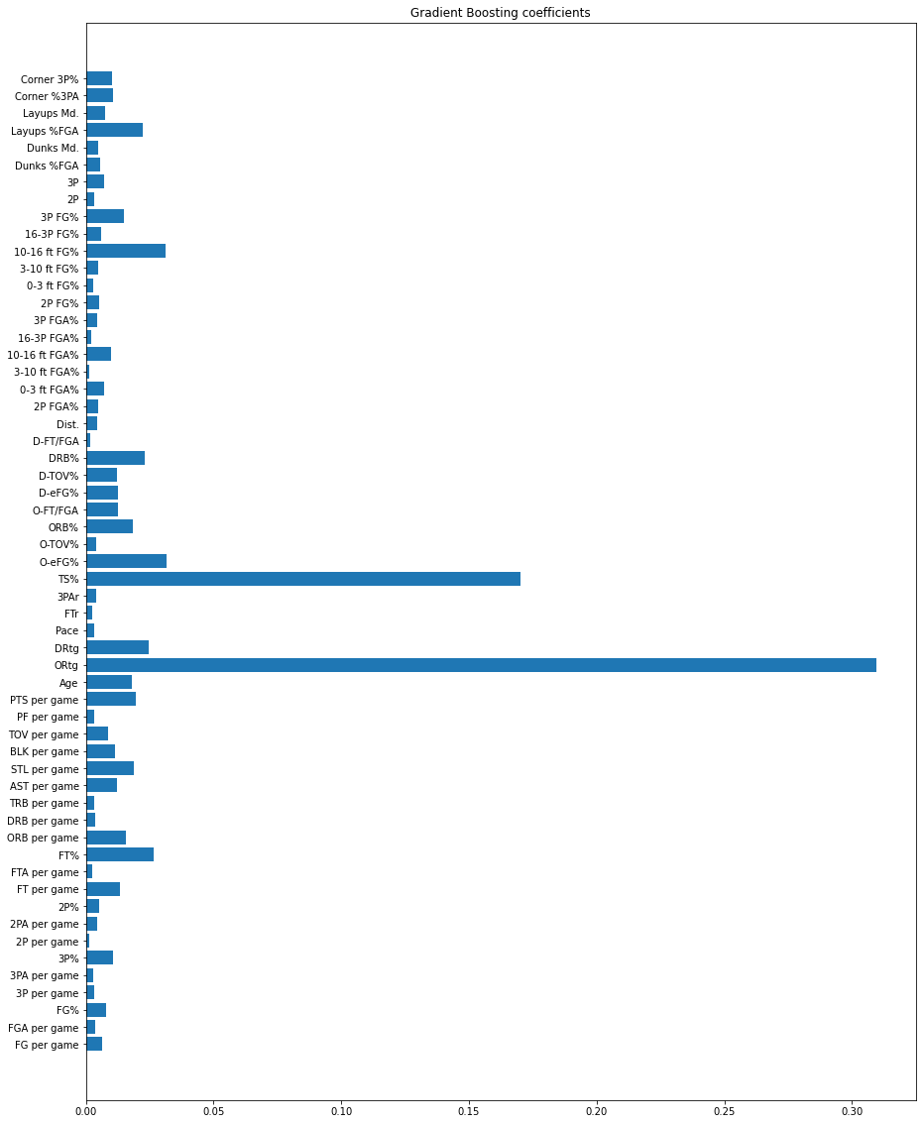
All Stats

Slide 14
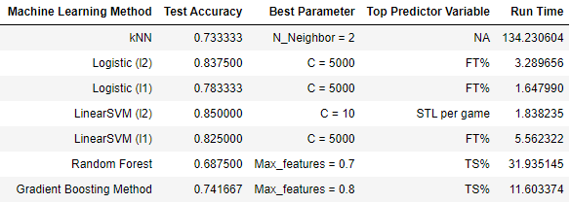
All stats without ORtg, DRtg and PPG

Slide 15
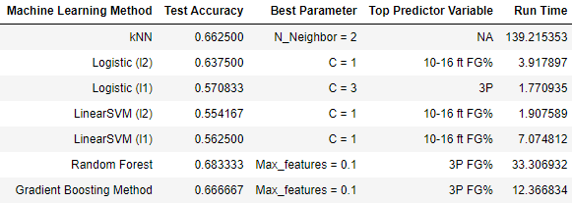
Shooting Stats
Notes:
Three-pointers dominate in today’s NBA with zone defense around stretching the floor compared to previous generations of the NBA

Slide 16
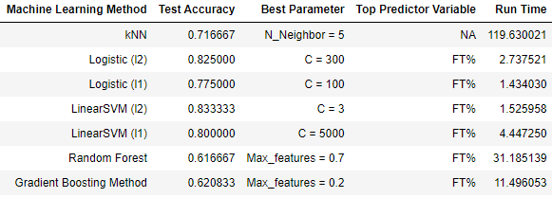
Basic Stats

Slide 17
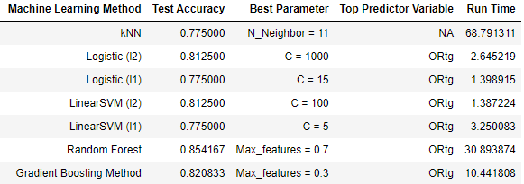
Advanced Stats
Offensive rating taking precedence when only advanced stats are included in the model testing but defensive rating narrowly takes precedence when all stats are accounted for.
Notes:
An explanation for this may be that it has something to do with the optimization of weights of the algorithm, since it would likely change if you choose a different set/subset of features, if some predictor variables are close enough in weight, either of them may take precedence depending on the set/subset of features included. We can see anyway that ORtg and DRtg have a strong correlation with teams' regular season success, even with eye tests

Slide 18
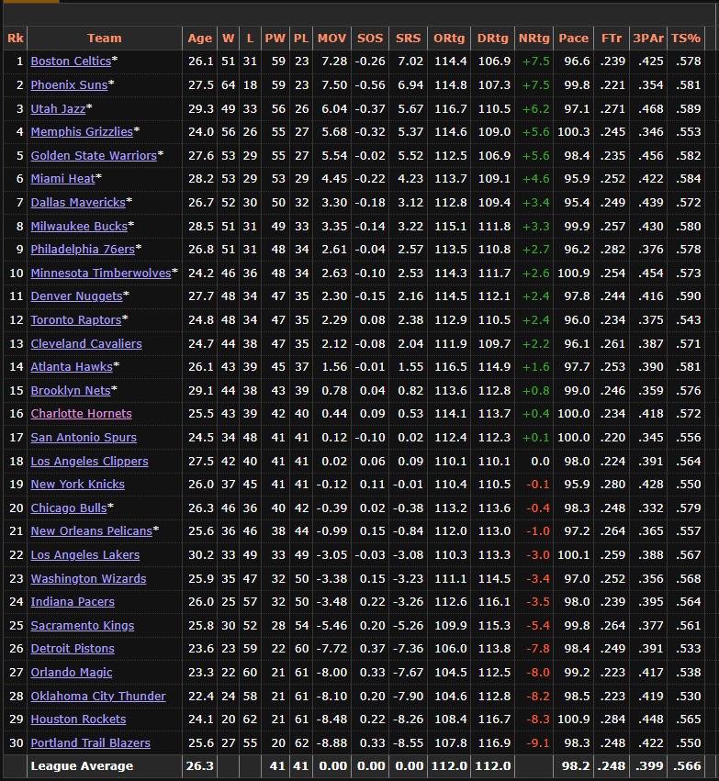
Advanced Stats
Even going by eye-tests, you can see the clear correlation between regular season success and offensive/defensive rating*
*Note: Offensive rating is better the higher it is, defensive rating better the lower it is

Slide 19
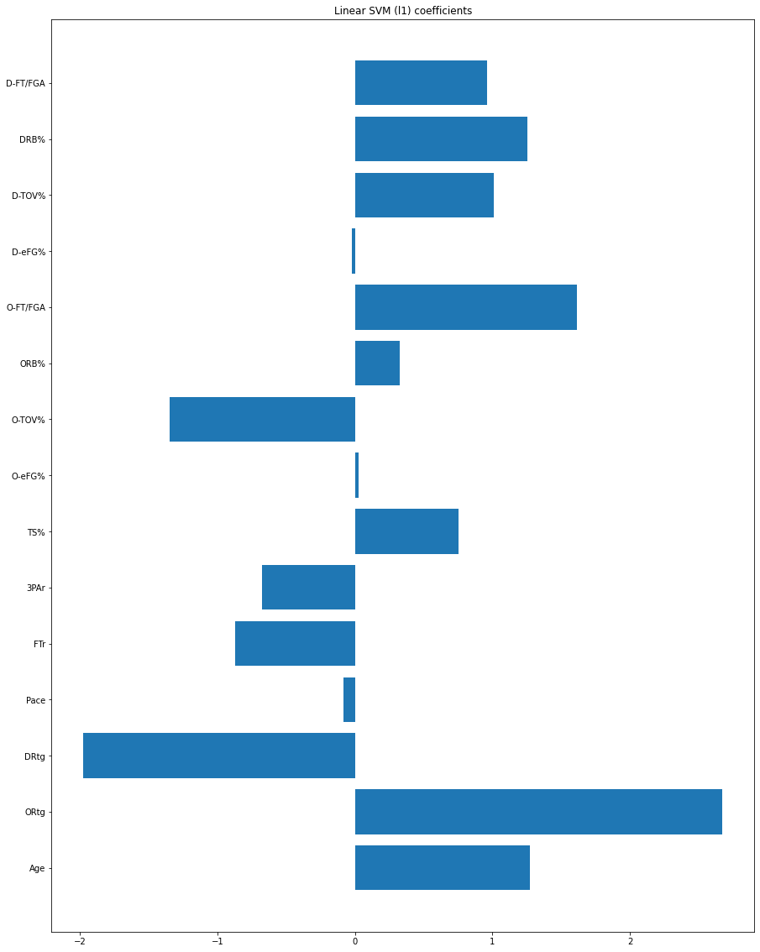
Advanced Stats
Offensive and defensive rating have the most weight among all predictor variables in majority of the model tests
*Note: Offensive rating is better the higher it is, defensive rating better the lower it is

Slide 20
Recommendations
Refine 3P shooting
Practice free throws
Distance shooting dominates in today’s stretched NBA court
Free throws are the easiest points in the game, make the most out of them
Improve defense
Balance team age
Defense wins games. Bill Russell won eleven rings doing so.
Every team needs veterans to lead and help nurture young talent

